Slide 1
ClickHouse Multi Array Join
per-row cartesian product of arrays

Slide 2
Array Join in ClickHouse
Suppose we have a table:
restaurantid|meals |drinks |
------------+-------------------+----------------+
1|['Salmon','Steak'] |['Wine','Beer’] |
2|['Sushi','Chicken']|['Tea',’Coffee’]|
Where meals Array(String), drinks Array(String)

Slide 3
Convert array element to rows
SELECT * FROM test_multi_array_join ARRAY JOIN meals
restaurantid|meals |drinks |
------------+-------+---------------+
1|Salmon |['Wine','Beer']|
1|Steak |['Wine','Beer']|
2|Sushi |['Tea','coffe']|
2|Chicken|['Tea','coffe']|

Slide 4
Multiple arrays Join in ClickHouse :
ARRAY JOIN meals, drinks
restaurantid|meals |drinks|
------------+-------+------+
1|Salmon |Wine |
1|Steak |Beer |
2|Sushi |Tea |
2|Chicken|Coffee|
It’s sum of 2 arrays

Slide 5
Cartesian product of arrays
Expected result of ARRAY JOIN meals ARRAY JOIN drinks
restaurantid|meals |drinks|
------------+-------+------+
1|Salmon |Wine |
1|Salmon |Beer |
1|Steak |Wine |
1|Steak |Beer |
2|Sushi |Tea |
2|Sushi |Coffee|
2|Chicken|Tea |
2|Chicken|Coffe |

Slide 6
ClickHouse does not support multiple ARRAY JOIN
Suppose the syntax of cartesian product of arrays is:
ARRAY JOIN arr1 ARRAY JOIN arr2.
Received exception from server (version 19.18.1):
Code: 48. DB::Exception: Received from localhost:9000. DB::Exception: Support for more than one ARRAY JOIN in query is not implemented.

Slide 7
Ideas
Most Clauses are processed similarly, so do the Array Join
Follow the logic of current ARRAY JOIN.
Use a different set of objects for the feature
Why? Will not touch the current code of the array join, will not break existing systems.

Slide 8
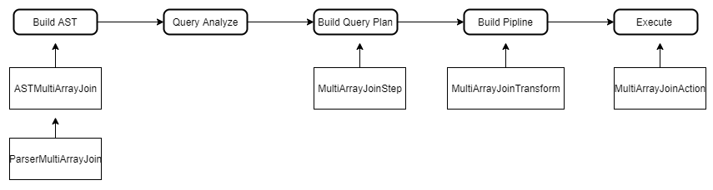
ARRAY JOIN Clause in the Query flow
Objects in each stage
Applies to most clauses

Slide 9
The implementation include:
Objects needed for Multi Array Join
Build AST of Multi Array Join
Query Analyze, optimization
Build query plan, pipeline
Execution of the functionality

Slide 10
New objects
AST of the Multi Array Join
struct ASTMultiArrayJoin : public IAST
Parser to handle the multiple array join AST
class ParserMultiArrayJoin : public IParserBase
Action object to process the Multi Array Join details
class MultiArrayJoinAction
Processor to Execute Multi ARRAY JOIN
class MultiArrayJoinTransform : public ISimpleTransform
QueryPlanStep object used to build Pipeline
class MultiArrayJoinStep : public ITransformingStep

Slide 11
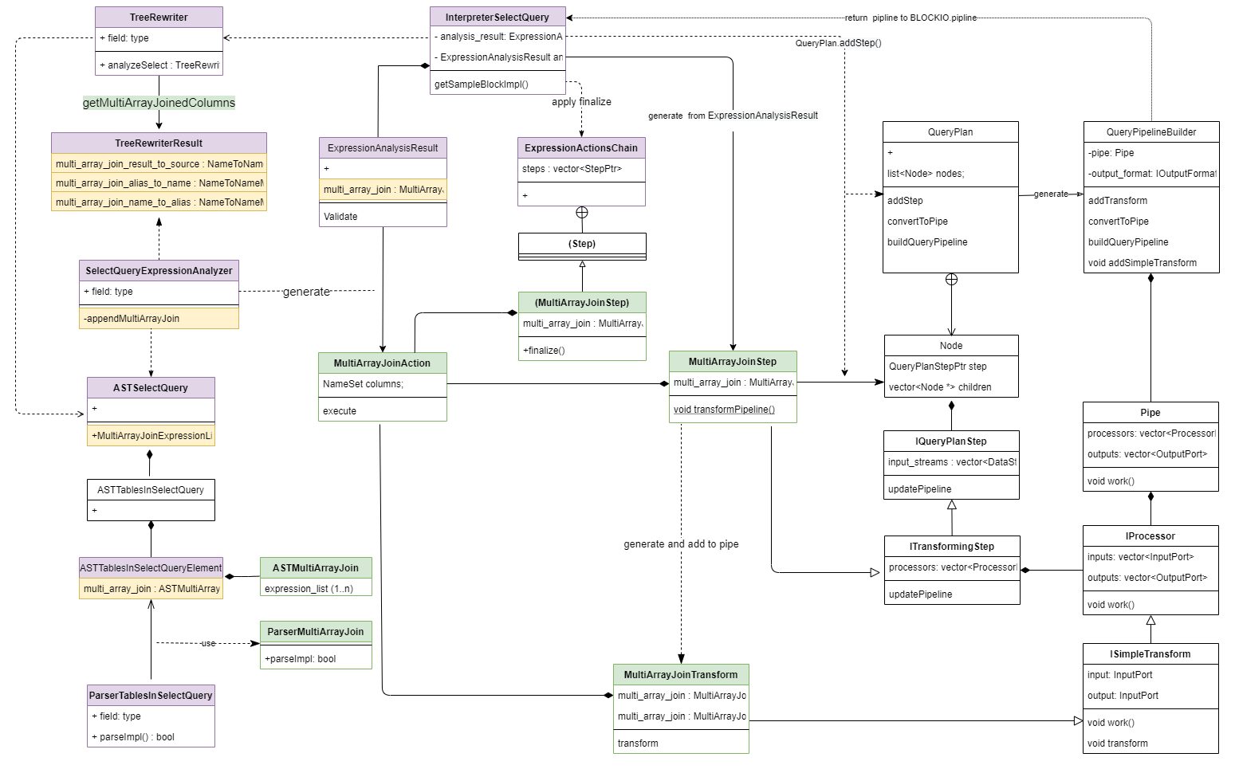
Objects Relationship: class diagram

Slide 12
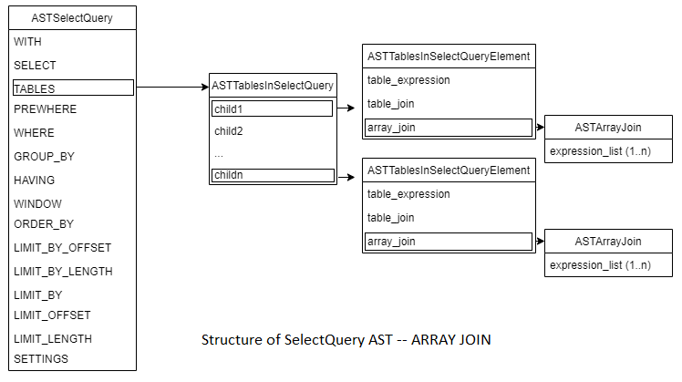
Build AST of Multi Array Join
Current AST if there are multiple ARRAY JOIN
ClickHouse will raise exception when building Query Plan

Slide 13
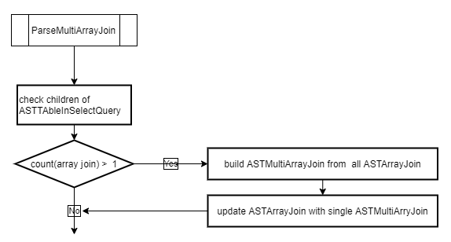
Build AST of Multi Array Join
check the children of ASTTablesInSelectQuery
if there's only one array join, do nothing
otherwise update the ASTArrayJoin with ASTMultiArrayJoin.

Slide 14
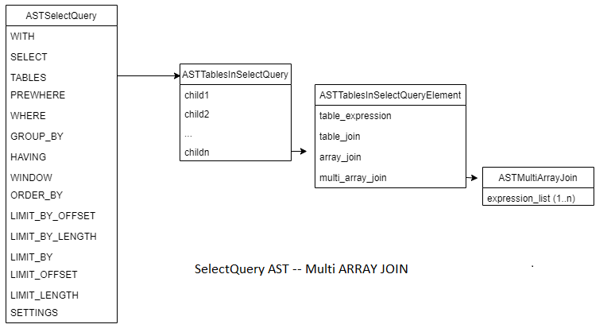
Build AST of Multi Array Join
AST after rebuild Multi Array Join

Slide 15
Query Analysis
Get and format multi array join columns
Generate operation object for multi array join
This object will do the real cartesian product of arrays
Fill up Analysis Result
If This result has the multi array join operation object then can be added to query plan

Slide 16
Related Objects and functions
Class TreeRewriter - rewrite AST
Function getMultiArrayJoinedColumns – get columns to the TreeRewriterResult
Struct TreeRewriterResult – hold the columns info
Class ASTSelectQuery – need to expose MultiArrayJoin
Class SelectQueryExpressionAnalyzer – Generate operation object (MultiArrayJoinAction)
Struct ExpressionAnalysisResult - holds info of MultiArrayJoinAction

Slide 17
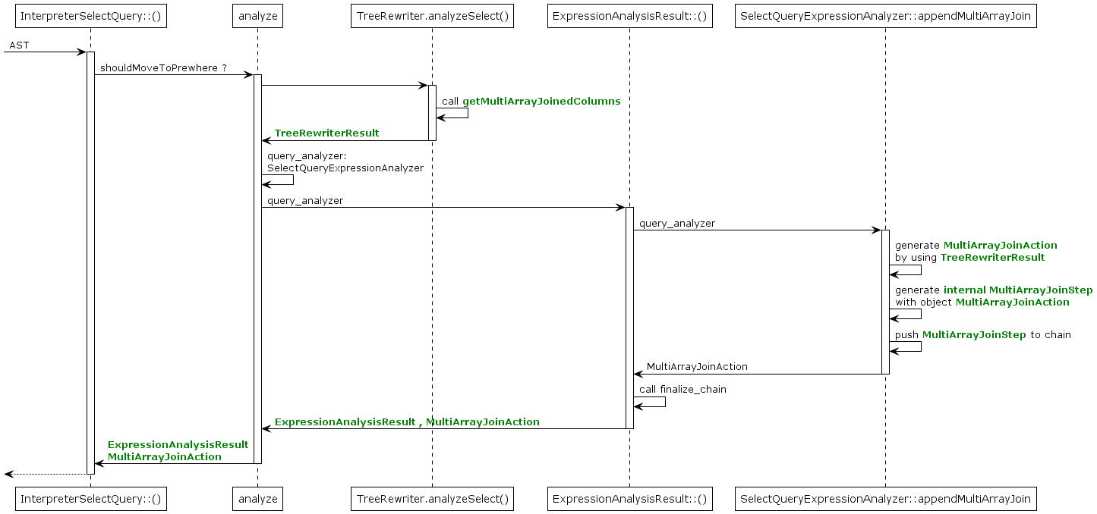
Analysis sequence
Return MultiArrayJoinAction
Fill up ExpressionAnalysisResult

Slide 18
Build query plan
Create Multi Array Join Step and add to query plan
void InterpreterSelectQuery::executeImpl(QueryPlan & query_plan ...)
{
...
if ExpressionAnalysisResult has multi_array_join then :
generate object of MultiArrayJoinStep
Add to query plan by query_plan.addStep
...
}

Slide 19
Update Pipeline
During the pipeline building, ITransformingStep::updatePipeline is called.
transformPipeline is called finally. MultiArrayJoinTransform is created.
void MultiArrayJoinStep::transformPipeline(QueryPipelineBuilder & pipeline, ...)
{
generate MultiArrayJoinTransform object;
Add to pipeline by pipeline.addSimpleTransform
}

Slide 20
Excution of the functionality
when the pipeline is executed, MultiArrayJoinTransform::transform will be called
The virtual method work() of IProcessor is called to run 'transform' of created instance of subclass.
MultiArrayJoinAction is used to do final work.
void MultiArrayJoinTransform::transform (Chunk & chunk)
{
Get Block from the chunk
Excute the MultiArrayJoinAction
update the chunk
}

Slide 21
Generate Result , update BLock
MultiArrayJoinAction is executed by MultiArrayJoinTransform
void MultiArrayJoinAction::execute(Block & block)
{
Process unaligned column if required
Process Left Join if required
for every column in the block:
if contained in the column list of array join then:
do cartesian product join
update the block
}

Slide 22
